Slide 1

8 Week SQL Challenge
Case Study #8 - Fresh Segments

Slide 2
Introduction
Danny created Fresh Segments, a digital marketing agency that helps other businesses analyze trends in online ad click behavior for their unique customer base.
Clients share their customer lists with the Fresh Segments team who then aggregate interest metrics and generate a single dataset worth of metrics for further analysis.
In particular - the composition and rankings for different interests are provided for each client showing the proportion of their customer list who interacted with online assets related to each interest for each month.
Danny has asked for your assistance to analyze aggregated metrics for an example client and provide some high level insights about the customer list and their interests.

Slide 3
Data Exploration and Cleansing
Update the fresh_segments.interest_metrics table by modifying the month_year column to be a date data type with the start of the month
What is count of records in the fresh_segments.interest_metrics for each month_year value sorted in chronological order (earliest to latest) with the null values appearing first?
What do you think we should do with these null values in the fresh_segments.interest_metrics
How many interest_id values exist in the fresh_segments.interest_metrics table but not in the fresh_segments.interest_map table? What about the other way around?
Summarise the id values in the fresh_segments.interest_map by its total record count in this table
What sort of table join should we perform for our analysis and why? Check your logic by checking the rows where interest_id = 21246 in your joined output and include all columns from fresh_segments.interest_metrics and all columns from fresh_segments.interest_map except from the id column.
Are there any records in your joined table where the month_year value is before the created_at value from the fresh_segments.interest_map table? Do you think these values are valid and why?

Slide 4
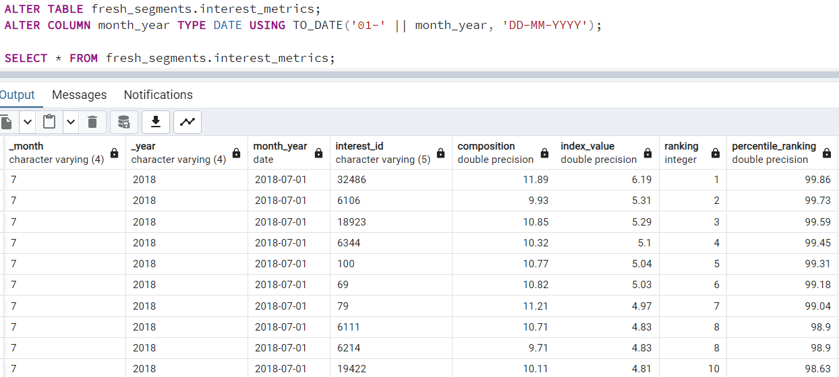
A. Data Exploration and Cleansing
1. Update the fresh_segments.interest_metrics table by modifying the month_year column to be a date data type with the start of the month

Slide 5
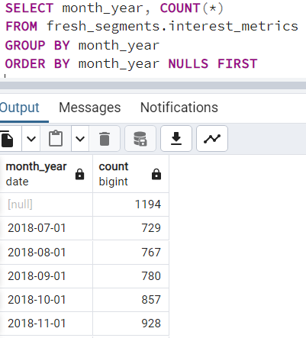
2. What is count of records in the fresh_segments.interest_metrics for each month_year value sorted in chronological order (earliest to latest) with the null values appearing first?

Slide 6

3. What do you think we should do with these null values in the fresh_segments.interest_metrics
The Null values appear in _month, _year, month_year, interest_id whereas the composition, index_value, ranking, percentile_ranking are not NULL but they do no have meaning without information on interest_id and Date.
We can check the values by calculating the percentage of NULL values present.
The null percentage is less than 10% hence we can drop the values.

Slide 7

4. How many interest_id values exist in the fresh_segments.interest_metrics table but not in the fresh_segments.interest_map table? What about the other way around?
There are totally 1202 unique interest_id in interest_metrics.
There are totally 1209 unique interest_id in interest_map.
There are no interest_id that did not appear in interest_map. All 1202 are present in interest_metrics.
There are 7 interest_id in interest_map that are not present in interest_metrics.

Slide 8
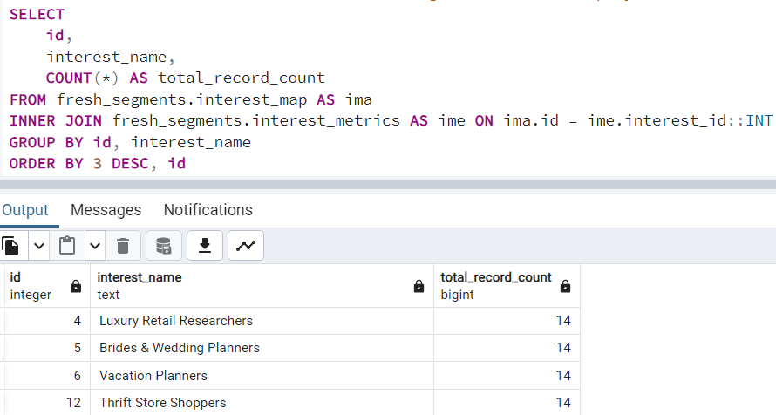
5. Summarise the id values in the fresh_segments.interest_map by its total record count in this table

Slide 9
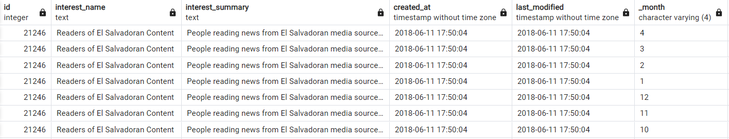
6. What sort of table join should we perform for our analysis and why? Check your logic by checking the rows where interest_id = 21246 in your joined output and include all columns from fresh_segments.interest_metrics and all columns from fresh_segments.interest_map except from the id column.
ANSWER : We should perform a Inner join

Slide 10
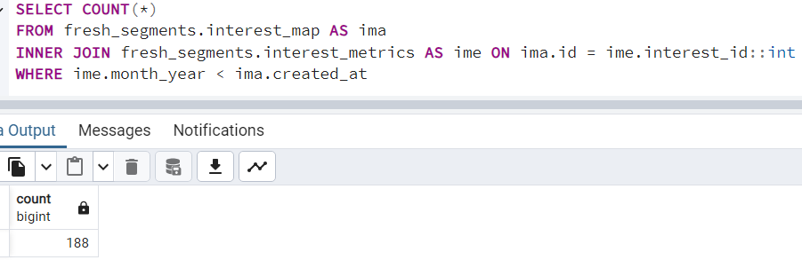
7. Are there any records in your joined table where the month_year value is before the created_at value from the fresh_segments.interest_map table? Do you think these values are valid and why?
There are 188 Records where month_year date is before created_at date.

Slide 11
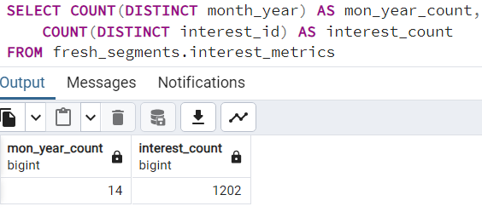
B. Interest Analysis
1. Which interests have been present in all month_year dates in our dataset?

Slide 12
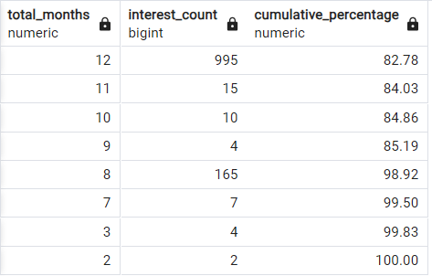
2. Using this same total_months measure - calculate the cumulative percentage of all records starting at 14 months - which total_months value passes the 90% cumulative percentage value?
ANSWER: Total months value with 8,7,3,2 are passing the 90% cumulative percentage value

Slide 13
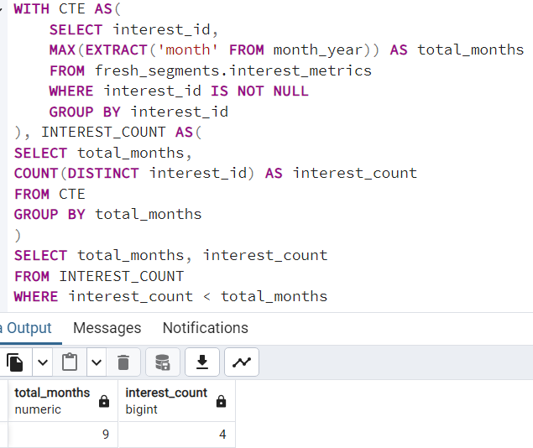
3. If we were to remove all interest_id values which are lower than the total_months value we found in the previous question - how many total data points would we be removing?

Slide 14
4. Does this decision make sense to remove these data points from a business perspective? Use an example where there are all 14 months present to a removed interest example for your arguments - think about what it means to have less months present from a segment perspective.
Removing data points where the number of months represented by the interest_id is less than the total_months value might make sense from a business perspective, depending on the context and objectives of the analysis.

Slide 15
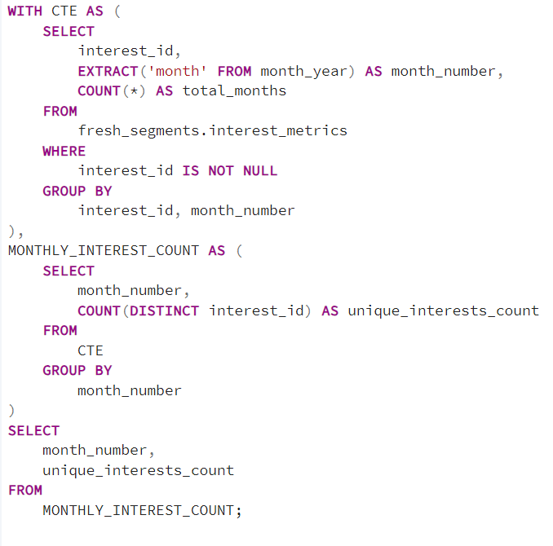
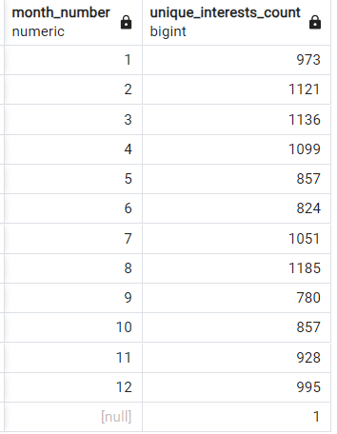
5. After removing these interests - how many unique interests are there for each month?

